Slide 1

Mystery Machine
Sprint 4

Slide 2
Sprint Goal
SSM ParamStore - Setup infrastructure config params - Execute IaC script manually in Ind Sys NonProd AWS Account
Create VPC - Execute IaC script manually in Ind Sys NonProd AWS Account
Create Admin Role in Ind Sys NonProd AWS Account; and enable developer login to AWS using Admin Role to execute IaC scripts

Slide 3
Infrastructure as Code (IaC)
Infrastructure as Code (IaC) is a method to provision and manage IT infrastructure through the use of source code, rather than through standard operating procedures and manual processes.
You’re basically treating your servers, databases, networks, and other infrastructure like software. And this code can help you configure and deploy these infrastructure components quickly and consistently.
Benefits:
Automate your deployment and recovery process
Rollback with the same tested process
Don’t Repair, Redeploy
Minimization of risk
Speed and simplicity; Cost savings
Test your infrastructure before deploying to the actual AWS environment
This would help in spinning up the whole new environment, testing your services, and destroying the environment in the AWS account
The same scripts can be used to set up the environment in AWS Brazil region within no time if needed.

Slide 4
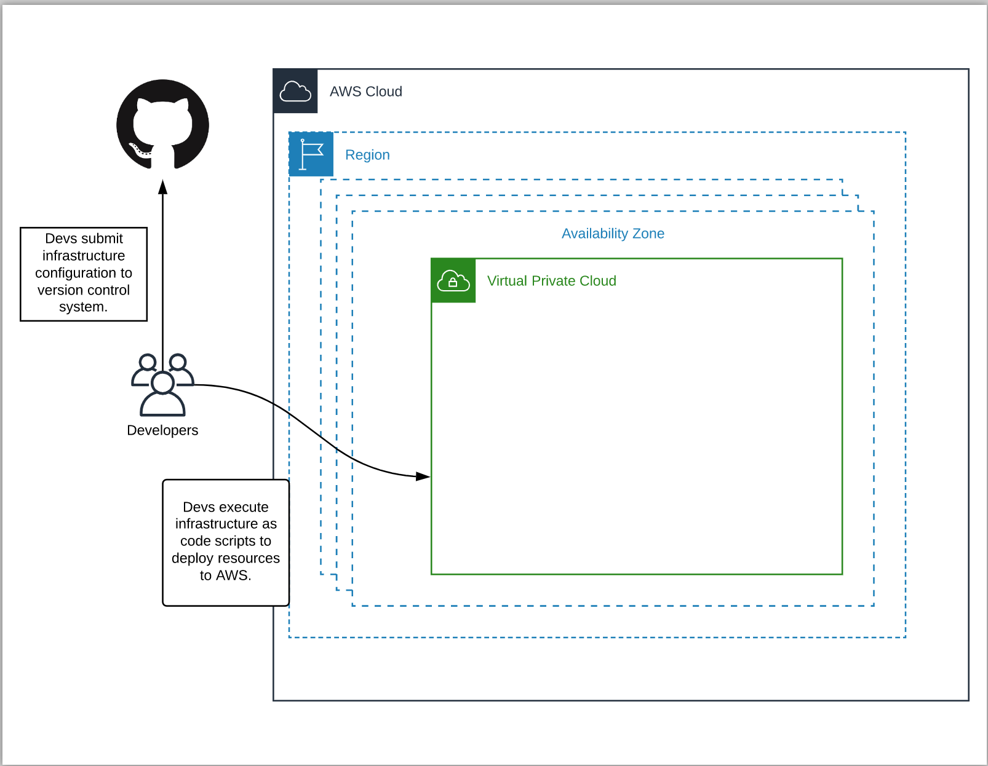
IaC

Slide 5
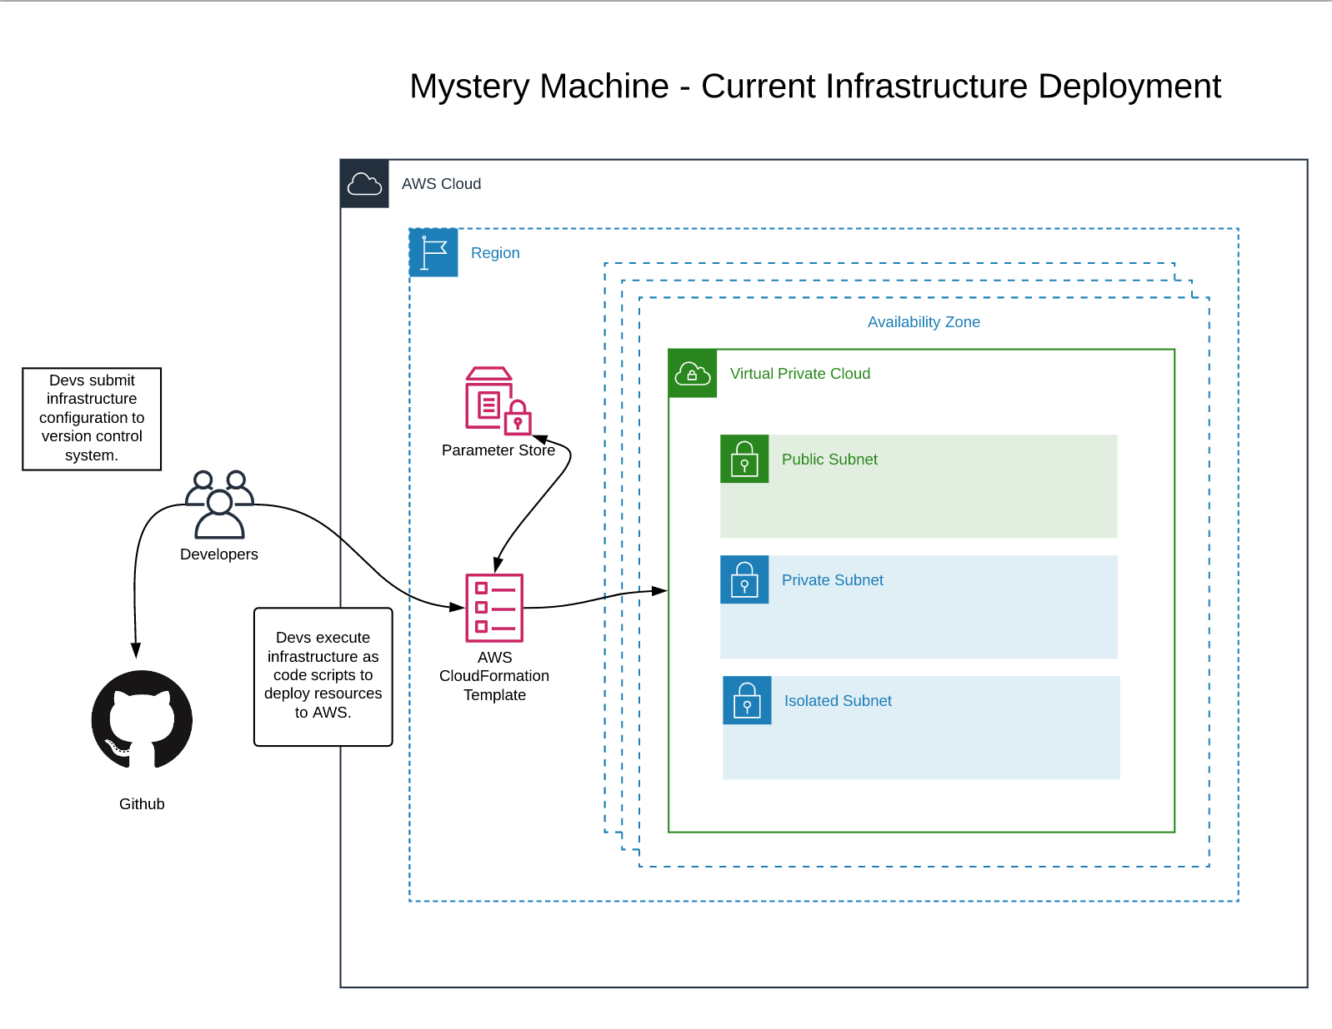

Slide 6
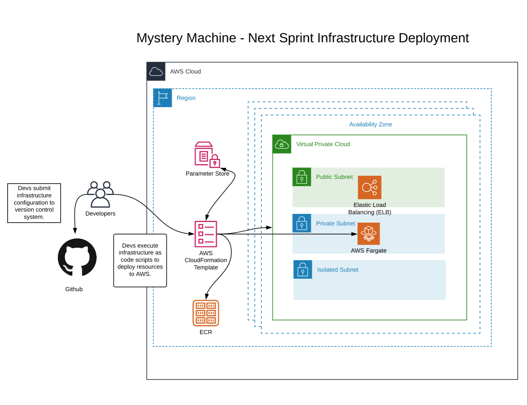

Slide 7
Next Sprint Goal
Automate minimal deployment pipeline
Highlights:
Build a sample service application and dockerize the application
Create and configure ECR
Create and configure ECS with Fargate cluster
Configure deployment of ECS with Fargate apps into the Industry System Non-Production account

Slide 8
